Slide 1
2012 Student recruitment
Notes:
Thanks everyone for coming.
Thought I’d start by giving you a quick update on our progress against the marketing strategy.

Slide 2
Key messages for Open Day
Employability
Environment
Fair fee

Slide 3
Employability
16th out all UK universities for ‘graduateness’ of jobs our students go into
Average graduate salary £22,400
Exceed benchmark for employability of our graduates – 92% against benchmark of 88.4%
Over the past three years our UK graduates have found work in 32 countries in five different continents.
Of our 23 core subject areas, 19 are in the upper half of the Unistats destination tables.
Placement opportunities – and the benefit they bring
Give specific examples for your own course

Slide 4
Environment
Top 10 of UK universities for environmental performance
New Business School
New Creative Arts Building
New student centre
Library resources, specialist resources for courses
Social spaces, coffee shops
Close to town centre, friendly environment
Opportunities for part time work through job shop

Slide 5
Fair fee
Fee is £7950 – we believe there is no need to charge more
No debt
Well managed University, with up to date resources
Students should ask other Unis why they feel they need to charge more.
Remember, no student pays, only graduates pay

Slide 6
Changes to Open Day
Emphasis has moved from School of Study to subject areas
Courses and information fair will now be just an information fair with only Services represented
Subject area stands will be based around the University in relevant areas
Emphasis on employability
Careers and Employability Service representation
Seven placement students

Slide 7
Changes to Open Day
New programme
On brand
Professional, clear and concise
Social Media Reps
Plasma screens – Twitter feed and 2012 messages
iHud Events
Professional communications
Tracking/conversion analysis

Slide 8
Open Day Programme

Slide 9
What messages are we sending?
iHud
New web platform
Clearer messages
Fresher images

Slide 10
Prospectus
Investment
Professional focus
Vocational experience
Value
Linked to web
People like you

Slide 11
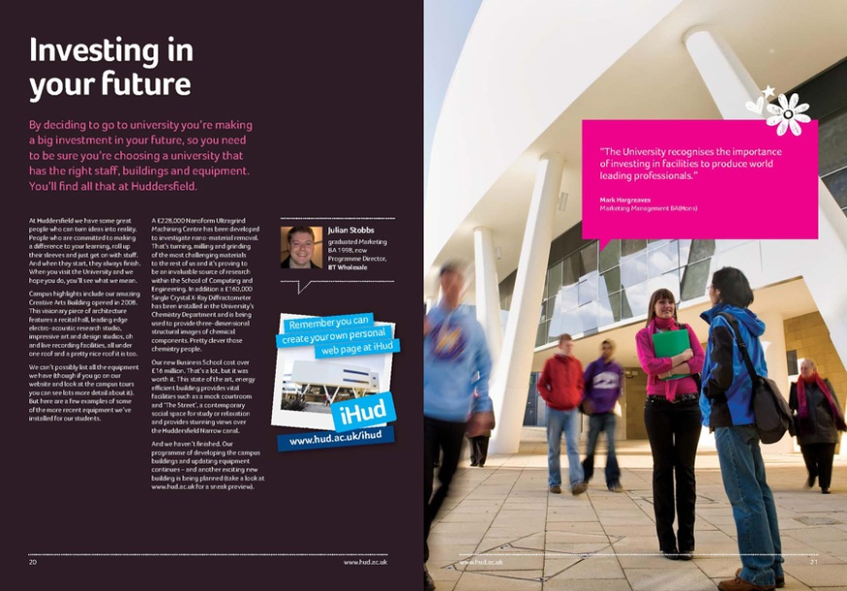
Prospectus : investment

Slide 12
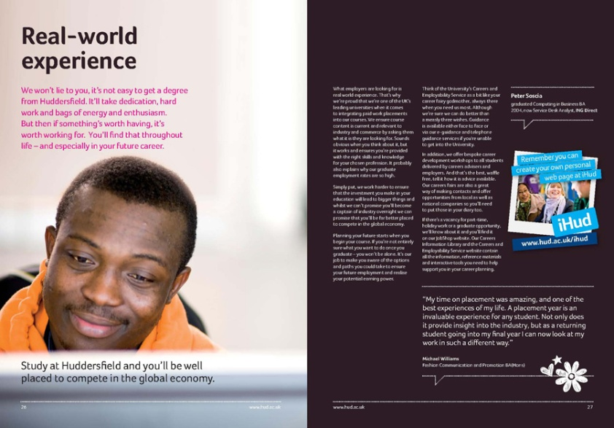
Prospectus: vocational

Slide 13
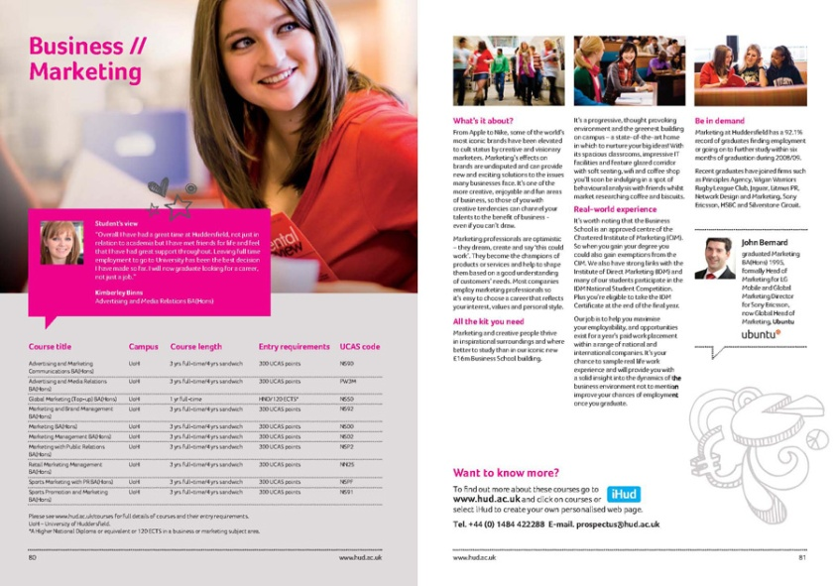
Prospectus : the offer

Slide 14
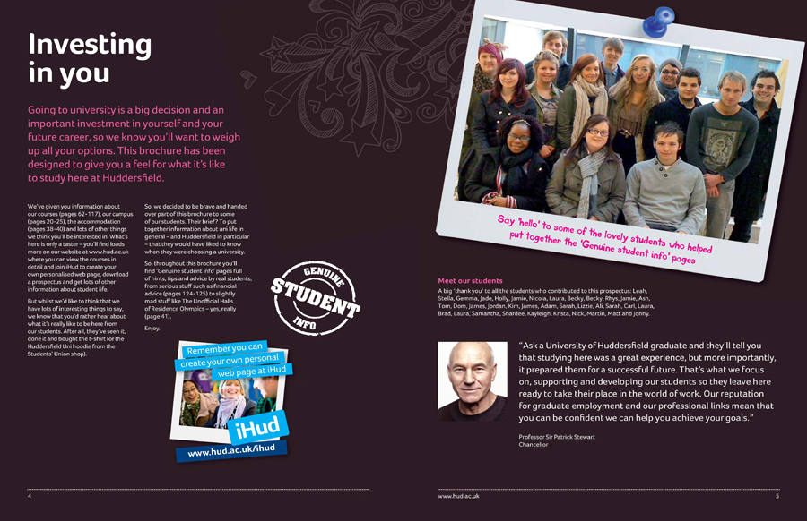
Prospectus : people like you

Slide 15
Prospectus : fun

Slide 16
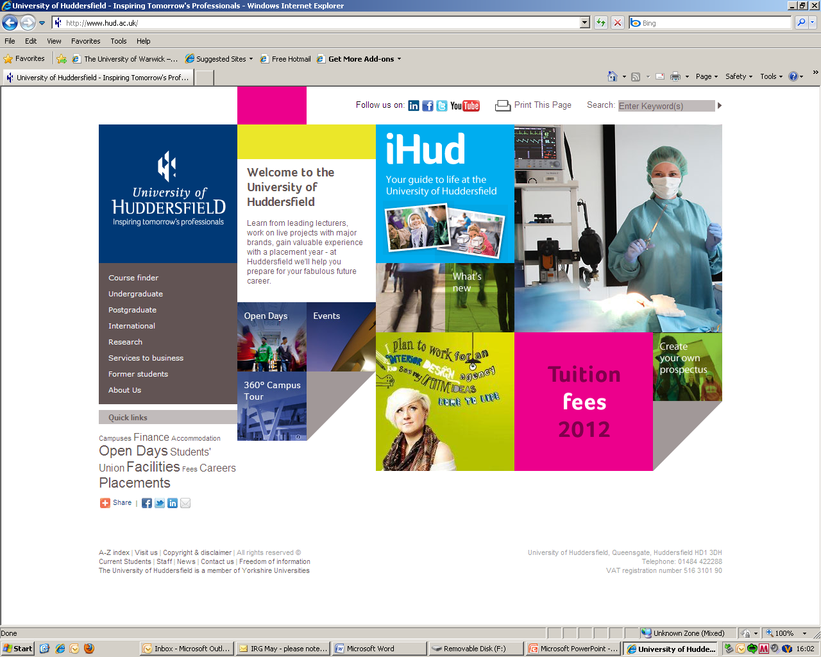
Website - undergraduate

Slide 17
iHud
Ties social media to database
Captures key info
Helps tailor information
Facilitates relationships

Slide 18
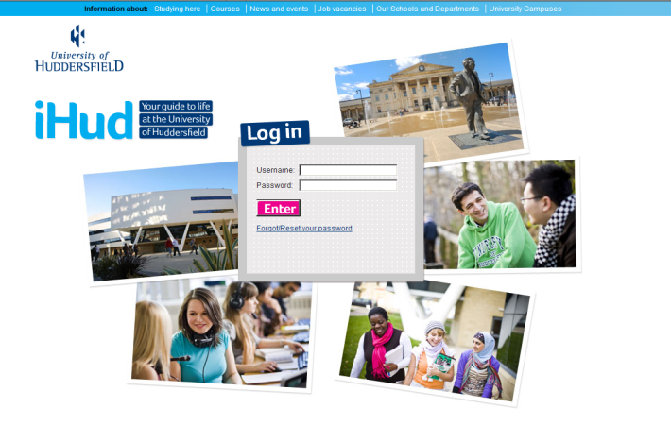
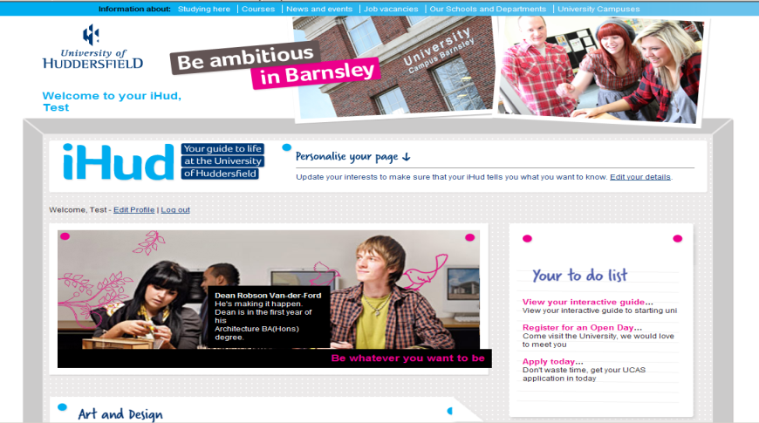
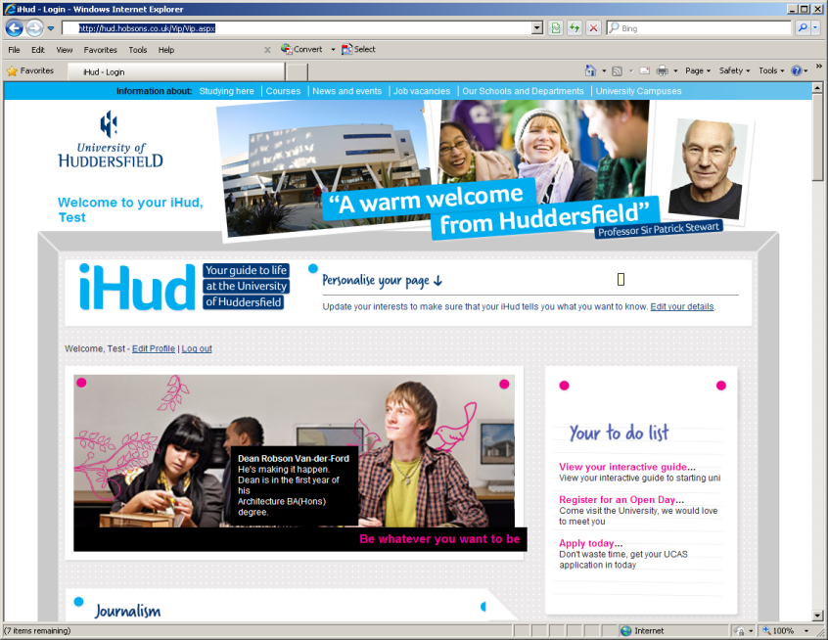
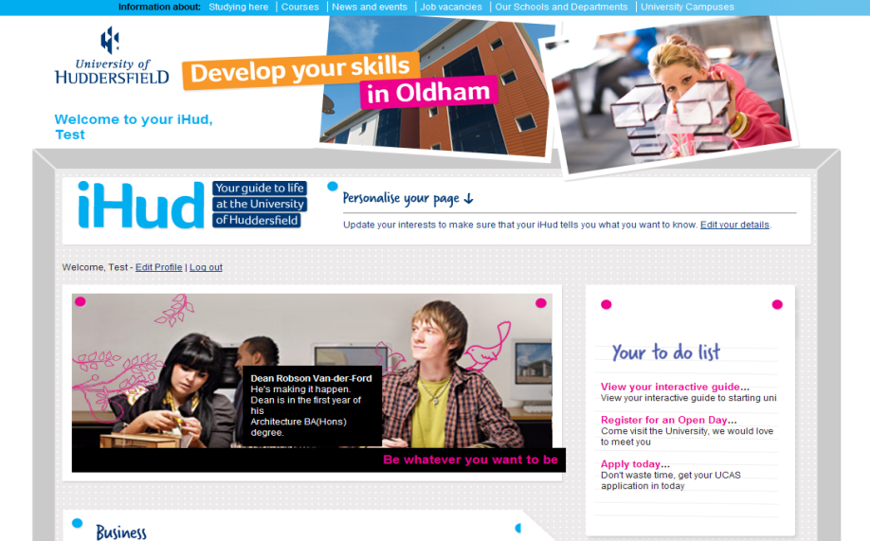
iHud pages

Slide 19
2012 campaign
investment in HE at Huddersfield
graduate employment
our professional links
academic excellence
facilities
social life

Slide 20
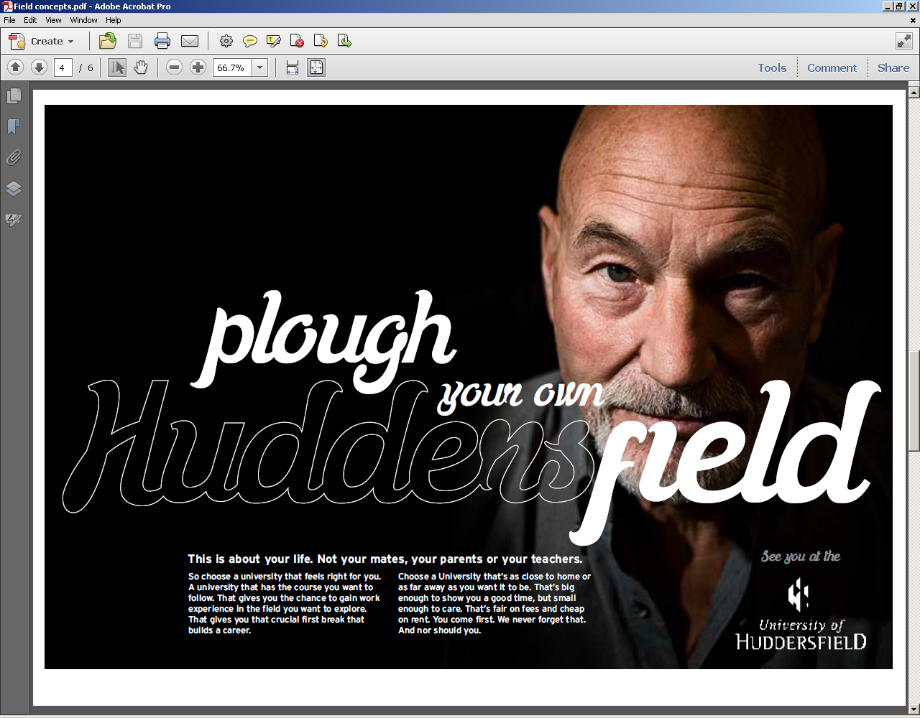
2012

Slide 21
What do we need to do?
Show why Huddersfield, and your course, is the one for them.
Showcase accreditations, professional links, graduate employment and alumni success, facilities.
Show your potential students that we are interested in each individual and his/her success.

